Slide 1
Twitter Sentiment Analysis
-BalaChander
-Arunnkumar
Guide:
Dr.R. Ramachandran
Notes:
Gud afternoon to everyone present here.
Our research title is twitter Sentiment analysis
This work done under the guidance of Dr. R. Ramachandiran,Associate Prof, Dept of IT
I have my teammate Balchander with me
Let me quickly go to todays agenda

Slide 2
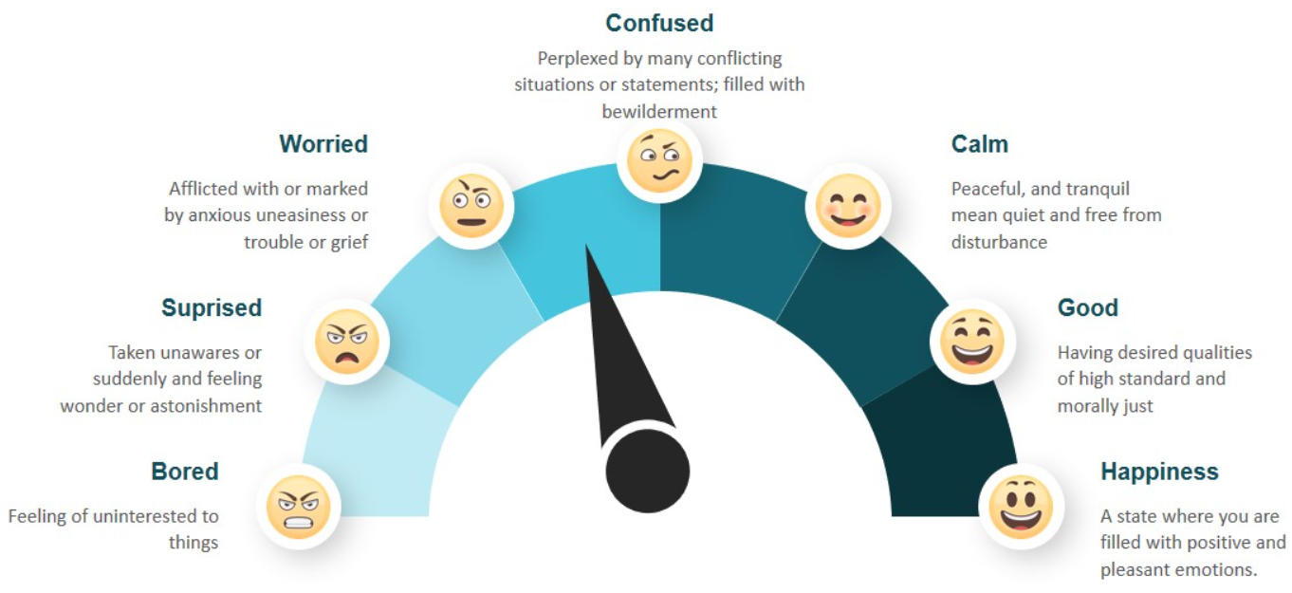
AGENDA
INTRODUCTION
LITERATURE REVIEW
PROBLEM STATEMENT
DRAWBACK OF EXISTING SYSTEM
PROPOSED SYSTEM
ARCHITECTURE
MODULES
IMPLEMENTATION
CONCLUSION
FUTURE WORK
REFERENCE
Notes:
First lets start with Into followed by lit survery then problem statement will be discussed
Exis sys along with its drabacks proposed system along with arch will also be discussed
And Module wise describtion along with the glimse of implementation followed by conclusion, future work and reference
Lets keep it aside and move on

Slide 3
INTRODUCTION
In the era of accelerating social media users, Twitter has a large number of regular users who post their views in the form of tweets. This paper proposes a method for collecting feelings from tweets as well as a method for categorising tweets as positive, negative, or neutral. Any business that is listed or tagged in a tweet will benefit from this strategy in a number of ways. Since most tweets are in an unstructured format, they must first be translated into a structured format. Tweets are resolved in this paper using a pre-processing phase, and tweets are accessed using libraries that use the Twitter API. The datasets must be trained using algorithms in such a way that they are capable of checking tweets and extracting the requisite sentiments from the feed. The goal of this research is to give an model to this fascinating problem and to present a framework which will perform sentiment analysis XGBOOST Classification. Furthermore, with the recent advancements in machine learning algorithms, the accuracy of our sentiment analysis predictions is able to improve. The main objective of this paper is to perform real time sentimental analysis on the tweets that are extracted from the twitter and provide time based analytics to the user
Notes:
Sentiment analysis, also refers as opinion mining
This paper proposes a method for collecting feelings from tweets
Most tweets are in an unstructured format, they must first be translated into a structured format
Using machine learning techniques and NLP we can extract the subjective information of a document and try to classify it according to its polarity
Sentiment Analysis (SA) can be applied in consumer products and services, financial services, social events, elections etc
recent advancements in machine learning algorithms, the accuracy of our sentiment analysis predictions is able to improve
main objective- to perform real time sentimental analysis on the tweets with high efficiency

Slide 4
MOTIVATION
Being extremely interested in everything having a relation with the Machine Learning, the independant project was a great occasion to give me the time to learn and confirm my interest for this field. The fact that we can make estimations, predictions and give the ability for machines to learn by themselves is both powerful and limitless in term of application possibilities. We can use Machine Learning in Finance, Medicine, almost everywhere. That’s why I decided to conduct my project around the Machine Learning
Notes:
Since we are deeply interested in everything which relates to ML concepts
The fact is that we can make estimations, predictions and give the ability for machines to learn by themselves
Moreover the response on twitter is more prompt and also more general
The most important criterion for this study is that it provides the user with a reasonably high degree of precision

Slide 5
PROBLEM STATEMENT
The project's aim is to do a sentiment study on a certain area. Sentiment will be categorised as positive, neutral, or negative; there will be no in-between categories. For example, if an emotion is positive or highly positive, both will be classified as "positive."This project will create a variety of tools and computer programmes, but it is important to remember that these are not the expected outputs. It is worth repeating that the project's output is the study of the target audience. That being said a system will have to be designed in order to perform this analysis. This method will collect data from Twitter, cleanse it, and then categorise it. The classified data would then be subjected to review. The most important criterion for this study is that it provides the client with a reasonably high degree of precision. The study' findings must be addressed in such a way that a client with little technical experience can comprehend them. Many applications include analysing consumer opinion, including companies attempting to evaluate the demand reaction to their goods, political election forecasting, and socioeconomic trends such as stock exchange forecasting. The aim of this project is to construct a practical classifier that can reliably and instantly characterise an unknown tweet stream's sentiment.
Notes:
The result of sentiment analysis is classification of natural language text into classes such as positive, negative and neutral
The classified data would then be subjected to review
Sentiment analysis is very necessary in today’s world,
if any one wants to purchase a product or to watch a movie, etc. then that person will first wants to know what are other people reviews, reactions and opinions about that product or movie on social media websites like Twitter
. So there is a need of system that can automatically generate sentiment analysis from this huge amount of data.

Slide 6
LITERATURE SURVEY
Title | Algorithm Used | Dataset | Description
AndranikTumasjan, Timm O. Sprenger, Philipp G. Sandner, Isabell M. Welpe (2018).(Andranik, Timm, Philipp, & Isabell, 2017) | Unigram Naive Bayes | 104,003 tweets | [1]Twitter is used as a forum for political deliberation and whether online messages on Twitter validly mirror offline political sentiment. Our results show that Twitter is indeed used extensively for political deliberation. We find that the mere number of messages mentioning a party reflects the election result.
Duyu Tang, Furu Wei, Nan Yang, Ming Zhou, Ting Liu, Bing Qin (2017)(Tang et al., 2019) | NB enhanced SVM | 12002 tweets | [2]The unified model combining syntactic context of words and sentiment information of sentences yields the best performance in both experiments
Pablo Gamallo, Marcos Garcia (2017)(Gamallo & Garcia, 2017) | Naive Bayes | 6,408 tweets | [3] The system makes use of fundamental rule that search’s for polarity words within the analysed tweets/texts. When the classifier is provided with a polarity lexicon and multiword.
Bian, Jiang, UmitTopaloglu, and Fan Yu.(2019)(Bian, Umit, & Fan, 2019) | NLP & SVM | 2 billion tweets | [4]Evaluation of the SVM was done using parameters such as the Area under the Curve (AUC) value, and the Receiver operating characteristic (ROC) curve. The ROC curve using the mean values of the 1000 iterations was drawn. The prediction accuracy on average over the 1000 iterations was evaluated to 0.74, and the mean AUC value is 0.82
Liu, Bingwei, Erik Blasch, Yu Chen, Dan Shen, and Genshe Chen (2020)(Liu, Blasch, Chen, Shen, & Chen, 2020) | Hadoop Classification | 1000 positive and 1000 negative tweets | [5]They tested their code on Cornell dataset and resulted in an 80.85% average accuracy. Without changing the Hadoop code, the program was able to classify different subsets of Amazon movie review dataset with comparable accuracy. To test the scalability of Naive Bayes classifier, the size of the dataset in their experiment varies from one thousand to one million reviews in each class.
Skuza, Michal, and Andrzej Romanowski.(2018). (Skuza & Romanowski, 2018) | Logistic Regression | 10000 tweets | [6] Twitter API to collect twitter data. Their training data falls in three different categories (camera, movie , mobile). The data is labeled as positive, negative and non-opinions. Tweets containing opinions were filtered. Unigram Naive Bayes model was implemented and the Naive Bayes simplifying independence assumption was employed. They also eliminated useless features by using the Mutual Information and Chi square feature extraction method. Finally , the orientation of an tweet is predicted. i.e. positive or negative.
Pablo Gamallo, Marcos Garcia (2017)(Gamallo & Garcia, 2017) | KNN | 18000 tweets | [7]This proposed a approach to utilize Twitter user- defined hastags in tweets as a classification of sentiment type using punctuation, single words, n-grams and patterns as different feature types, which are then combined into a single feature vector for sentiment classification. They made use of K-Nearest Neighbor strategy to assign sentiment labels by constructing a feature vector for each example in the training and test set.
ÁlvaroCuesta, David F., and María D. R-Moreno (2018)(Cuesta, Barrero, & RMoreno, 2018) | SVM | 50000 tweets | [8]This proposed a solution for sentiment analysis for twitter data by using distant supervision, in which their training data consisted of tweets with emoticons which served as noisy labels.They build models using Naïve Bayes, MaxEnt and Support Vector Machines (SVM). Their feature space consisted of unigrams, bigrams and POS. They concluded that SVM outperformed other models and that unigram were more effective as features
Notes:
DISADVANTAGES:
LR- Logistic Regression is the assumption of linearity between the dependent variable and the independent variables.
-number of observations is lesser than the number of features, Logistic Regression should not be used, otherwise, it may lead to overfitting
KNN -Accuracy depends on the quality of the data.
With large data, the prediction stage might be slow
NB- If your test data set has a categorical variable---- wasn't present in the training data set ZERO PROP
RF- ineffective for real-time predictions.
SVM- Long training time for large datasets.
-Difficult to interpret the final model

Slide 7
PROBLEM DEFINITION
With the rapid growth of the World Wide Web, people are using social media such as Twitter which generates big volumes of opinion texts in the form of tweets which is available for the sentiment analysis. This translates to a huge volume of information from a human viewpoint which make it difficult to extract a sentences, read them, analyze tweet by tweet, summarize them and organize them into an understandable format in a timely manner.
Notes:
People use social media such as Twitter, which produces large amounts of opinion, as a result of the rapid growth of the INTERNET.
It would be difficult to translate huge volume of data from human viewpoint to extract a sentences, read them, analyze tweet by tweet
describe them, and assemble them into a comprehensible format as soon as possible.
Decent amount of related prior work has been done on sentiment analysis of user reviews , documents, web blogs/articles.
These differ from twitter mainly because of the limit of 140 characters per tweet which forces the user to express opinion compressed in very short text.
It is a really useful analysis since we could possibly determine the overall opinion

Slide 8
EXISTING SYSYEM & DRAWBACKS
ALGORITHM/METHODLOGY USED | DEMERITS | ACCURACY
Logistic Regression | categorical variableot observed in training dataset | 85%
Nearest Neighbor Model | Accuracy depends on the quality of the data. | 80%
Naïve Bayes and ngrams | Accuracy is less | 78%
Random Forest | ineffective for real-time predictions. | 75%
SVM | Long training time for large datasets. | 88%
Notes:
DISADVANTAGES:
LR- Logistic Regression is the assumption of linearity between the dependent variable and the independent variables.
-number of observations is lesser than the number of features, Logistic Regression should not be used, otherwise, it may lead to overfitting
KNN -Accuracy depends on the quality of the data.
With large data, the prediction stage might be slow
NB- If your test data set has a categorical variable---- wasn't present in the training data set ZERO PROP
RF- ineffective for real-time predictions.
SVM- Long training time for large datasets.
-Difficult to interpret the final model

Slide 9
NEED OF SENTIMENT ANALYSIS
Industry Evolution
Research Demand
Decision Making
Understanding Context
Internet Marketing
Notes:
ie- Only the useful amount of data is required in the industry as compared to the set of complete unstructured form of the data
Any of the industries with the business to consumer will get benefit from this
RD-Present solutions for the purpose of sentiment analysis and opinion mining are rapidly evolving, specifically by decreasing the amount of human effort
the research theme that will be based in the long established disciplines of computer as text mining, machine learning
DM-The reviews and the opinions also help the people to take important decisions helping them in INVESTMENT and business areas
UC-As human language is getting very complex day by day so it has become difficult for the machine to be able to understand human language BCOZ Of their slang, misspelling,the cultural variation
IM-An important reason behind the increase in the demand of sentimental analysis is the marketing done via internet by the business and companies organization. Now they regularly monitor the opinion of the user about their brand, product, or event on blog or the social post

Slide 10
PROPOSED SYSTEM
Our aim is to perform sentiment analysis using data from Twitter. We're going to make a classifier out of a variety of machine learning classifiers. We'll proceed with the steps until our classifier is ready and educated.
Step-1 First we are going to stream tweets using Twitter Streaming API in our build classifier with the help of TextBlob library in python
Step-2 Then we pre-process these tweets, so that they can be fit for mining and feature extraction
Step-3 The preprocessed data is involved in tokenization, normalization. Since, Twitter is our source of data for analysis. We are going to stream the tweets from twitter in our database with NLTK Library. For this we are going to use Twitter Application.
Step-4 Then passed to our trained XGBOOST classifier, which then classify them into positive or negative class based on trained results.
Step-5 The classified data is inferred into various charts and analysis are made. It also allows to generate report of their classified data and files.
Notes:
After analyzing a number of classification techniques, We'll put forward a classifier <using a number of different machine learning classifiers.> which yields higher efficiency, speed and accuracy.
Entity & aspect extraction – textblob lib
Preprocess – text is highly unstructured, cant be redily processed without any preprocessing
The data is used to train the classifier with the help of nltk lib
Lib is very large and consists of structured set of text files which are used to train the dataset effectively

Slide 11
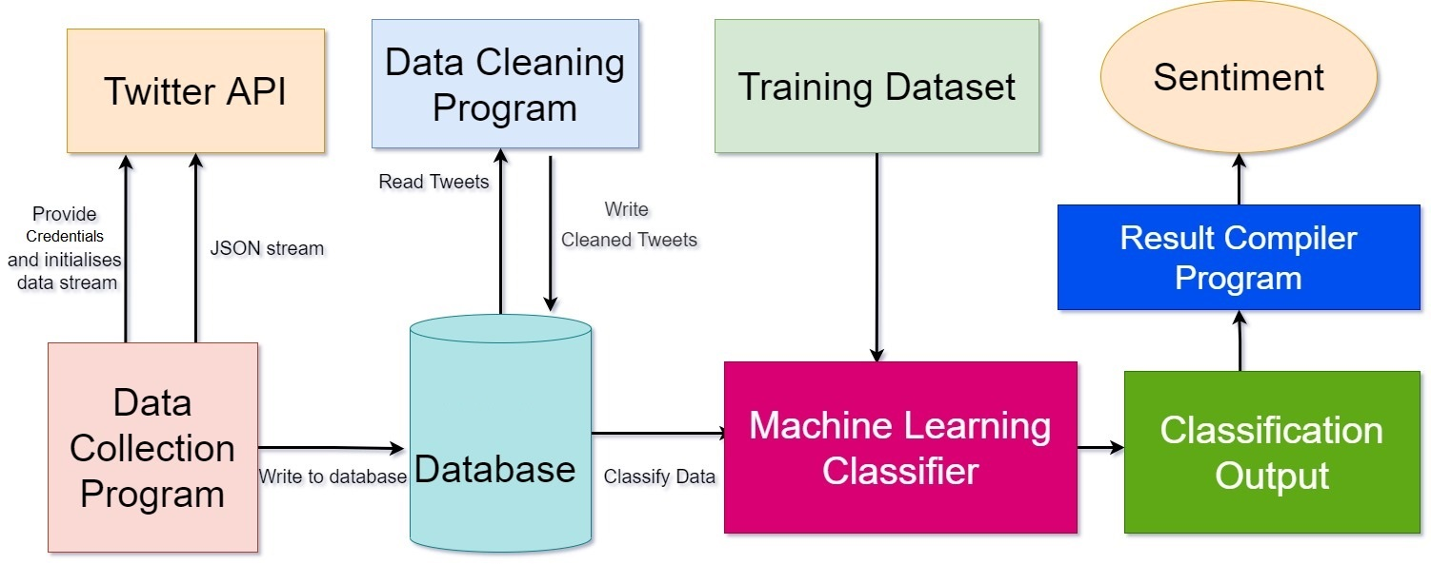
ARCHITECTURE

Slide 12
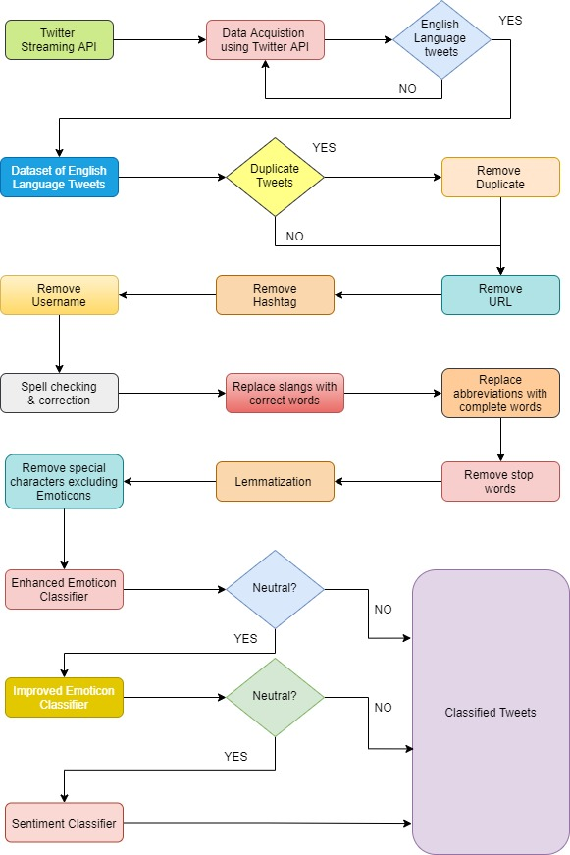
WORKFLOW
This article aims to provide a high-level overview of the data gathering, text classification, and machine learning algorithms used in this project. The fundamental organisation of a system, as expressed in its elements, their interactions with one another and with the environment, and the design and evolution principles
Notes:
Lemmatization is the process of converting a word to its base form
Provide a high-level overview of the data gathering, text classification, and machine learning algorithms used in this project

Slide 13





MODULES
Data Gathering
Data Preprocessing
Tokenization
Normalization
Data Training

Slide 14
MODULE WISE DESCRIPTION

Slide 15

DATA GATHERING
Twitter enables developers with a collection of streaming APIs that provide low-latency access to Twitter data flows. The public streams API was used for data collection; it was discovered that this was the best method of gathering information for data mining purposes because it provided access to a global stream of twitter data that could be filtered as needed
Notes:
Collecting data allows you to capture a record of past events so that we can use data analysis to find recurring patterns.
From those patterns, you build predictive models using machine learning algorithms that look for trends and prediction. Here we use Twitter Streaming API for data collection, because it provided access to a global stream of twitter data that could be filtered

Slide 16
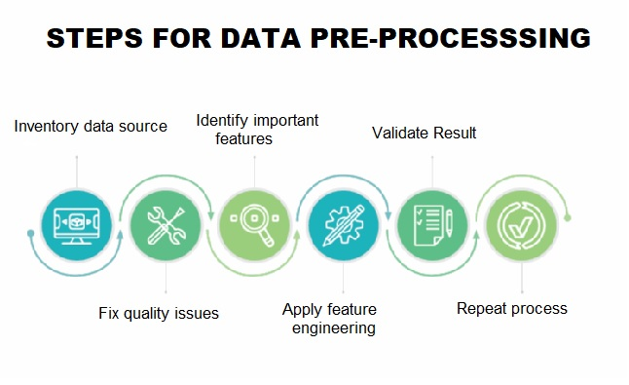
DATA PRE-PROCESSING:
Preprocessing a Twitter dataset involves a series of tasks like removing all types of irrelevant information like emojis, special characters, and extra blank spaces. It can also involve making format improvements, delete duplicate tweets, or tweets that are shorter than three characters
Notes:
Data preprocessing is a data mining technique that involves transforming raw data into an understandable format.
Real-world data is often incomplete, inconsistent, and/or lacking in certain behaviors or trends, and is likely to contain many errors.
Data preprocessing is a proven method of resolving such issues.
Pre-processing a Twitter dataset entails eliminating all kinds of unnecessary data such as emojis, special characters, and extra blank spaces, among other items. It can also include, deleting redundant tweets, or deleting tweets with less than three characters

Slide 17

TOKENIZATION
It is the process of breaking a stream of text up into words symbols and other meaningful elements called “tokens”. Tokens can be separated by whitespace characters and/or punctuation characters. It is done so that we can look at tokens as individual components that make up a tweet. Emoticons and abbreviations (e.g., OMG, WTF, BRB) are identified as part of the tokenization process and treated as individual tokens
Notes:
It is the method of separating a continuous stream of text into words, symbols, and other meaningful elements known as "tokens." Whitespace and punctuation characters may be used to distinguish tokens. It's done this way so that tokens can be viewed as individual components of a tweet.

Slide 18
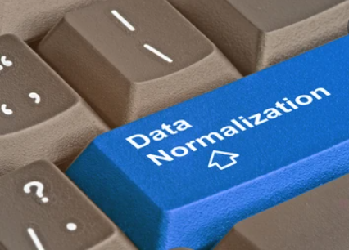
NORMALISATION
For the normalization process, the presence of abbreviations within a tweet is noted and then abbreviations are replaced by their actual meaning. We also identify informal intensifiers such as all-caps note their presence in the tweet. All-caps words are made into lower case, and instances of repeated characters are replaced by a single character. Finally, the presence of any special Twitter tokens is noted) and placeholders indicating the token type are substituted. Our hope is that this normalization improves the performance of the POS tagger, which is the last preprocessing step.
Notes:
The inclusion of abbreviations inside a tweet is identified for the normalisation process, and then abbreviations are replaced with their actual meaning.
It also look for informal intensifiers like all-caps OMG, RIP
This normalisation, we expect, will improve the output of the PartsOfSpeech tagger, which is the final phase before data training

Slide 19

DATA TRAINING
The training process is implemented correctly the machine learning algorithm should be able to generalize the training data so that it can correctly map new data that it has never seen before. Training data must contain a class label, this can be achieved through manually assigning each tweet with a class but this is a tedious process and as twitter enforces strict rules on the distribution of its data it has proved difficult to source reliable hand annotated twitter datasets.
Notes:
The dataset is used by a ML algorithm to learn how to map the input examples to their predicted targets.
The machine learning algorithm should be able to generalise the training data so that it can accurately map new data that it has never seen before if the training process is performed correctly.
Training data must have a class label, this can be accomplished by manually assigning a class to and tweet
It is time consuming because Twitter has strict rules about the distribution of its data.

Slide 20





TECHNOLOGY STACK
L
Notes:
Python- Python is an interpreted high-level general-purpose programming language
Django is a Python-based free and open-source web framework that follows the model-template-views architectural pattern,
DJ- collection of Python libs allowing you to quickly and efficiently create a quality Web application
TextBlob - provides a simple API for NLP) tasks such as part-of-speech tagging, noun phrase extraction, sentiment analysis, classification
HTML provides the structure of the page
CSS provides layout
javascript look and feel

Slide 21
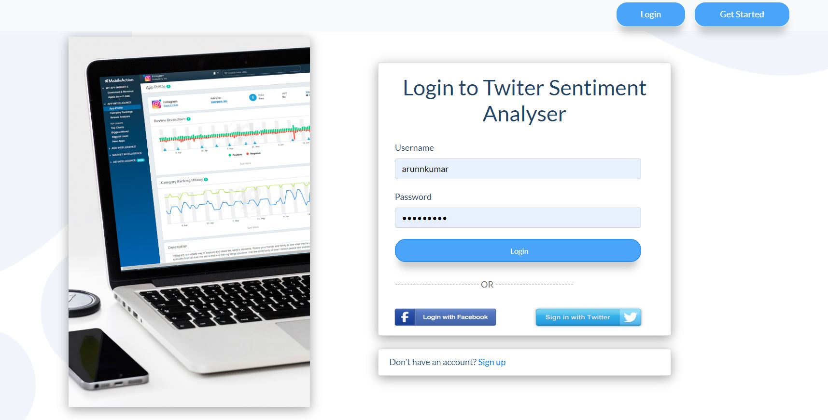
IMPLEMENTATION

Slide 22
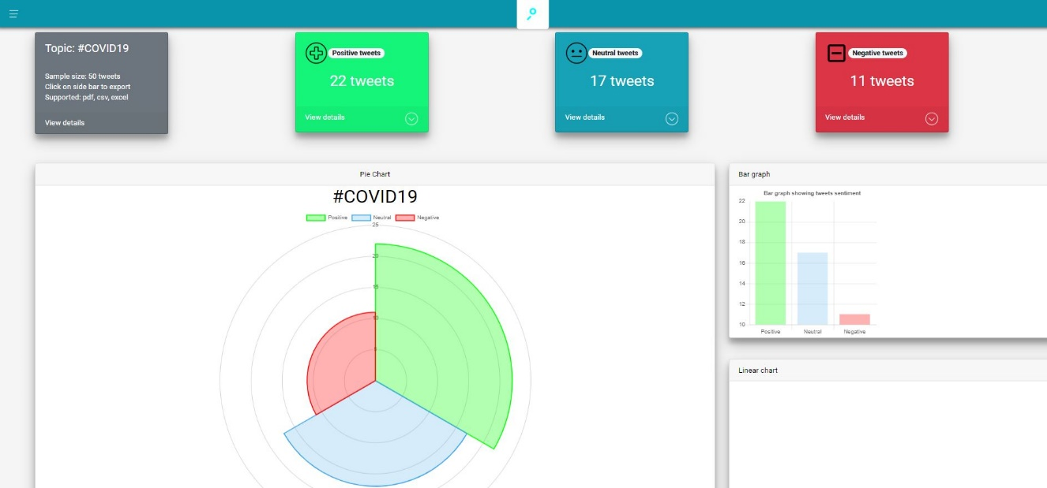

Slide 23
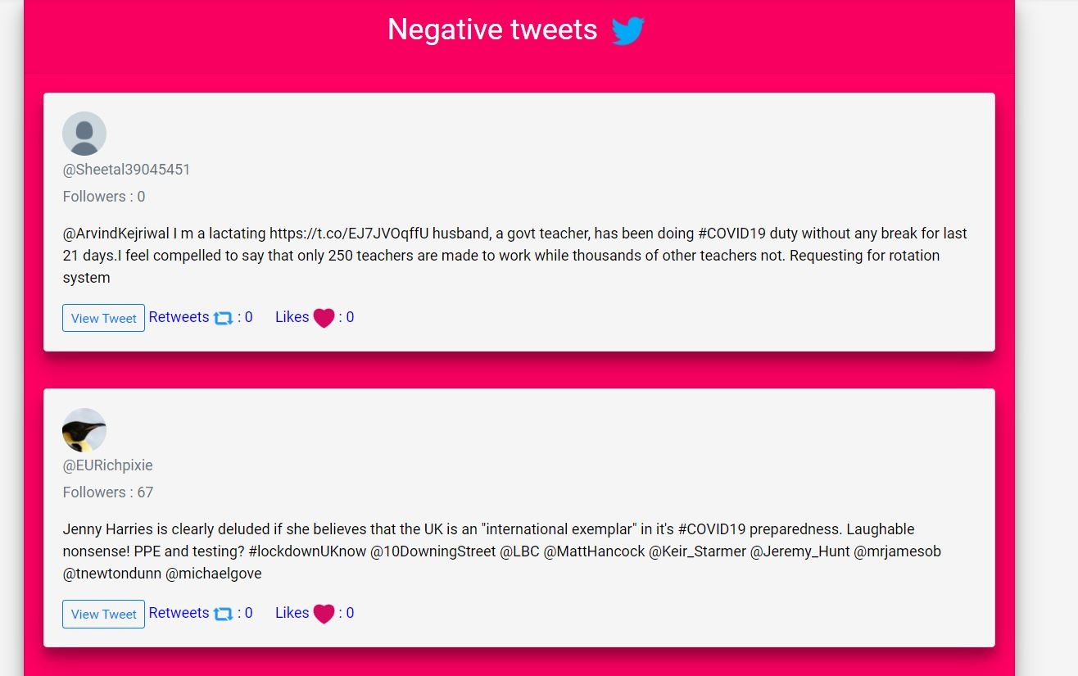

Slide 24
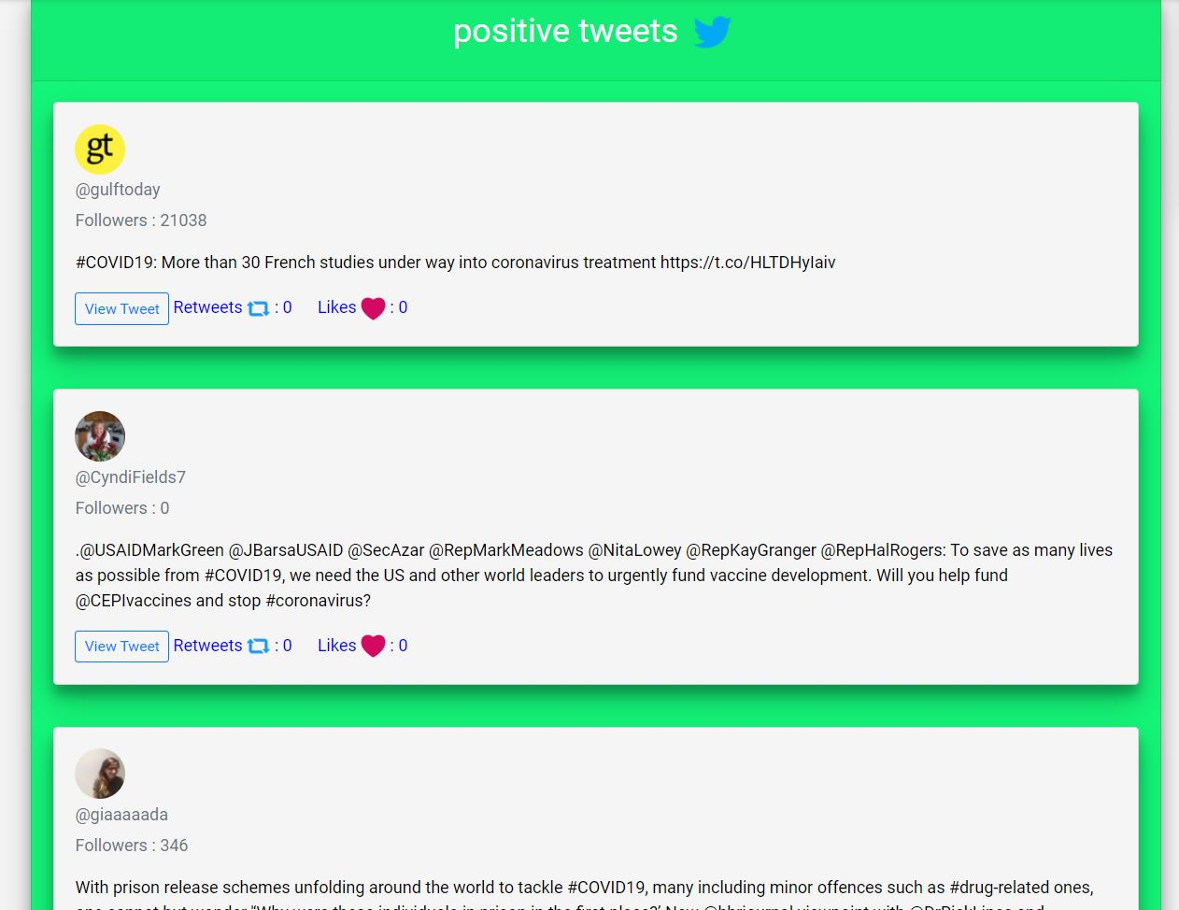

Slide 25
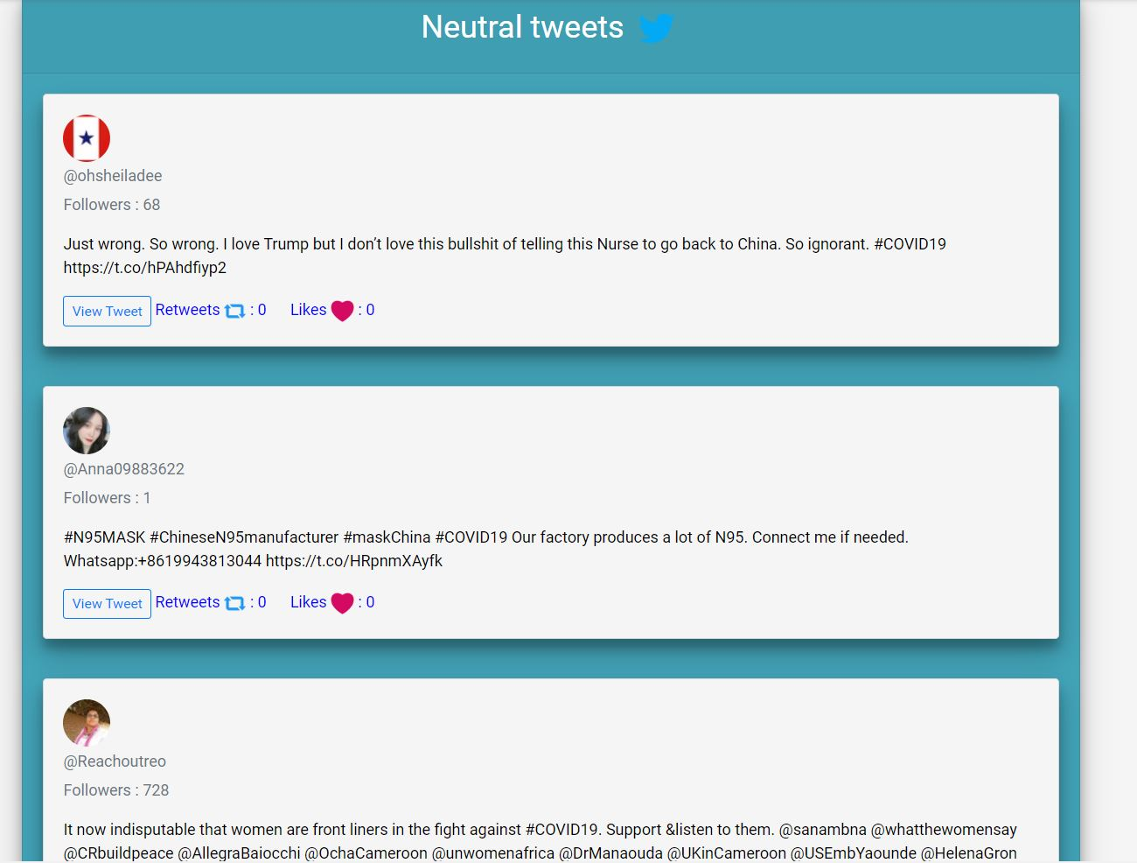

Slide 26
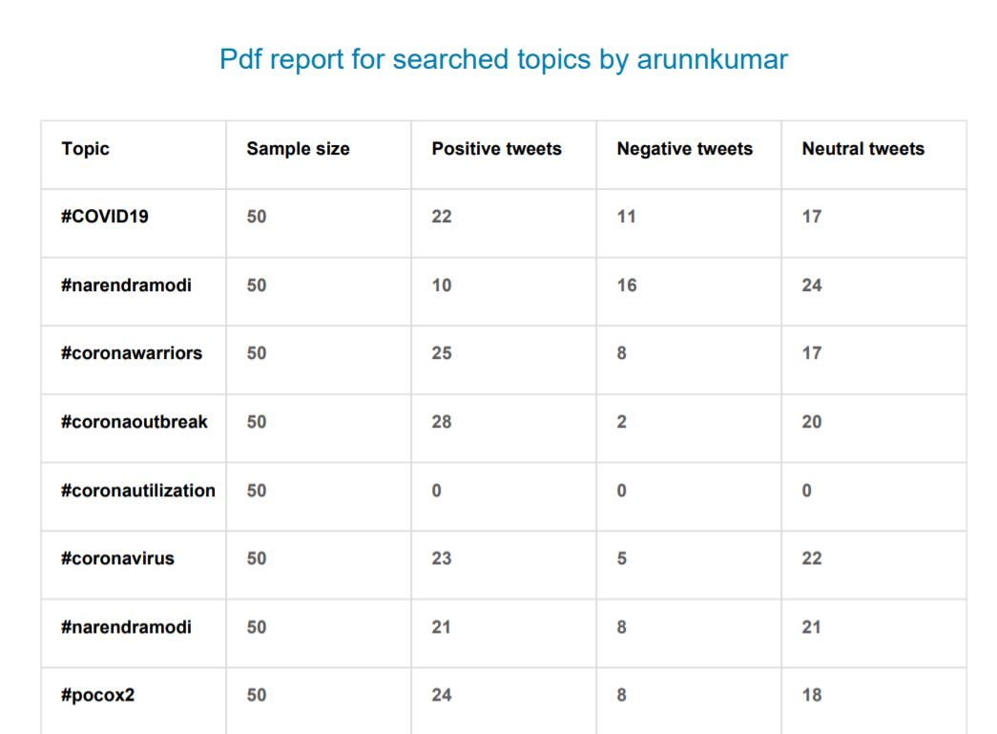

Slide 27
FUTURE SCOPE
Data Pre-Processing using more parameters to get best sentiments
Frequent updation of Dataset for new Synonym and Phrases of already existing words
Web-Application can be converted to Mobile Application
Context Sentimental Analysis may be implemented in future for accuracy purposes.
Notes:
Pre-processing data with more parameters to obtain the best sentiments
Dataset is updated on a regular basis to provide new keywords and phrases for terms that already exist.
Web-Application can be converted to Mobile Application
Contextual Sentimental Analysis can be implemented in favor of a particular business

Slide 28
CONCLUSION
Our solution provides the best technique to predict the sentiment analysis with an efficiency of 95%.
Machine-Learning Algorithm predicts and identifies the exact feedback/review of the user on a specific product.In future, this model focuses to enhance the accuracy of prediction.
The various approaches to sentiment analysis, primarily Machine Learning and Cognitive approaches, are discussed in depth in this study.
It gives a comprehensive overview of the numerous applications and challenges that Sentiment Analysis can present, making it a difficult task.
Notes:
The main aim of this is to generate the most accurate opinion of the user
With a 95% accuracy rate, our approach offers the finest technique for predicting sentiment analysis.
The user's exact feedback/review on a particular product is predicted and identified using a machine-learning algorithm.
This model's goal in the future is to improve prediction accuracy with a variety of data from different social media platforms.
This work explores into the multiple approaches to sentiment analysis, primarily Machine Learning and Cognitive approaches.

Slide 29
REFERENCES
[1] Efthymios Kouloumpis and Johanna Moore,IJCSI International Journal of Computer Science Issues, Vol. 9, Issue 4, No 3, July 2018
[2] S. Batra and D. Rao, ”Entity Based Sentiment Analysis on Twitter”, Stanford University,2019
[3] Saif M.Mohammad and Xiaodan zhu ,Sentiment Analysis on of social media texts:,2018
[4]Ekaterina kochmar,University of Cambridge,at the Cambridge coding Academy Data Science.2017
[5] Manju Venugopalan and Deepa Gupta ,Exploring Sentiment Analysis on Twitter Data, IEEE 2019
[6] Brett Duncan and Yanqing Zhang, Neural Networks for Sentiment Analysis on Twitter.2017
[7] Afroze Ibrahim Baqapuri, Twitter Sentiment Analysis: The Good the Bad and the OMG!, Proceedings of the Fifth International AAAI Conference on Weblogs and Social Media.2020

Slide 30
THANK YOU

